Slide 1
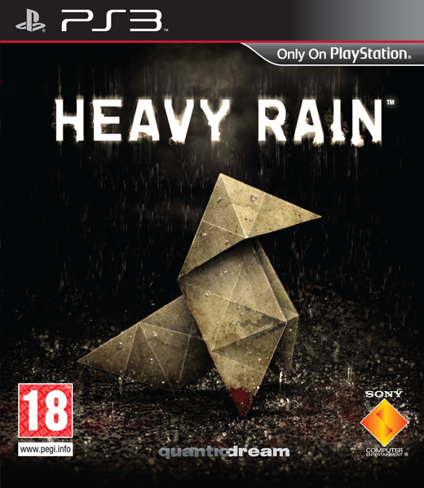

Slide 2
Basic Information
Title: Heavy Rain
Developer: Quantic Dream
Publisher: Sony Computer Entertainment
Genre: Cinematic Mystery/Drama
Price: $19.99 for Director’s Cut. $29.99 for the original (at gamestop.com).
Requirements: A PS3.

Slide 3
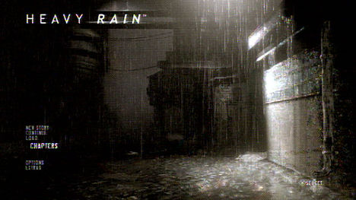

Slide 4
Game Summary
Overview
Heavy Rain has 22 different endings (6 main and 18 subplot).
Choices made by the player affect the ending and the rest of the gameplay.
The main purpose of gameplay is to advance the story, not to win or lose.
A person may consider some endings better and others worse, but there is no way to actually lose.

Slide 5
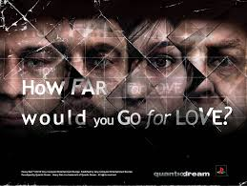

Slide 6
Game Summary
Story (without spoilers)
Set in an unnamed city, Heavy Rain is the story of the Origami Killer, a serial killer who gets his name from always leaving a piece of Origami with his victim.
Player’s Role
The player takes on the role of four different characters, whose stories all intertwine with that of the Origami Killer, and interacts with objects and NPCs to advance the story.

Slide 7
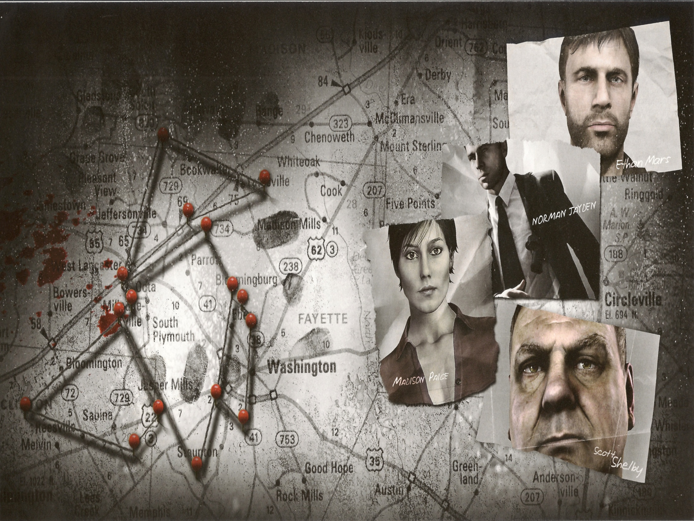

Slide 8
Game Summary
User Interface
Clean.
Emphasizes the cinematic aspect of the game.
Gameplay
Occasional high-action scenes, but generally pretty calm.
Generally intuitive. There were some bad choices that I’ll talk about later.

Slide 9
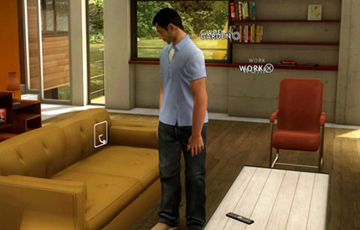
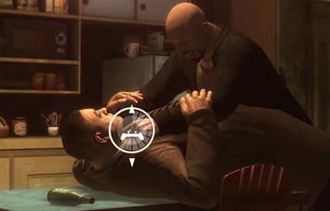

Slide 10
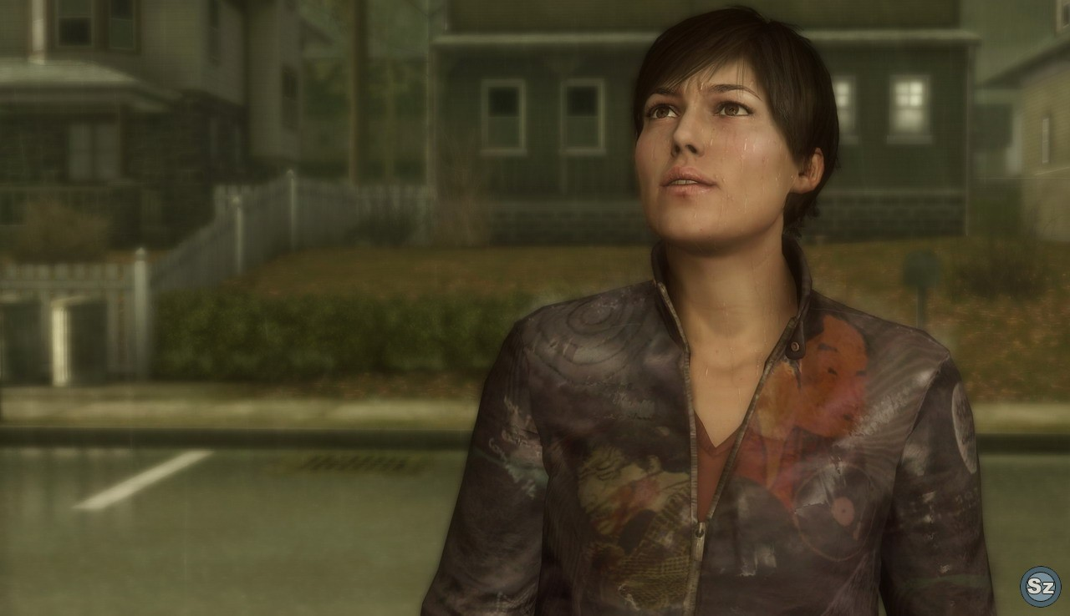
Game Summary
Art

Slide 11
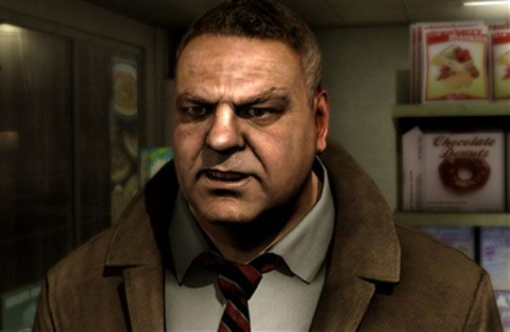
Game Summary
Art
Very good job on faces.
Hit or miss animation. Hands can be off when reaching for something.
Sound and Music
Wonderful, orchestral music.
Voice acting is hit or miss.

Slide 12
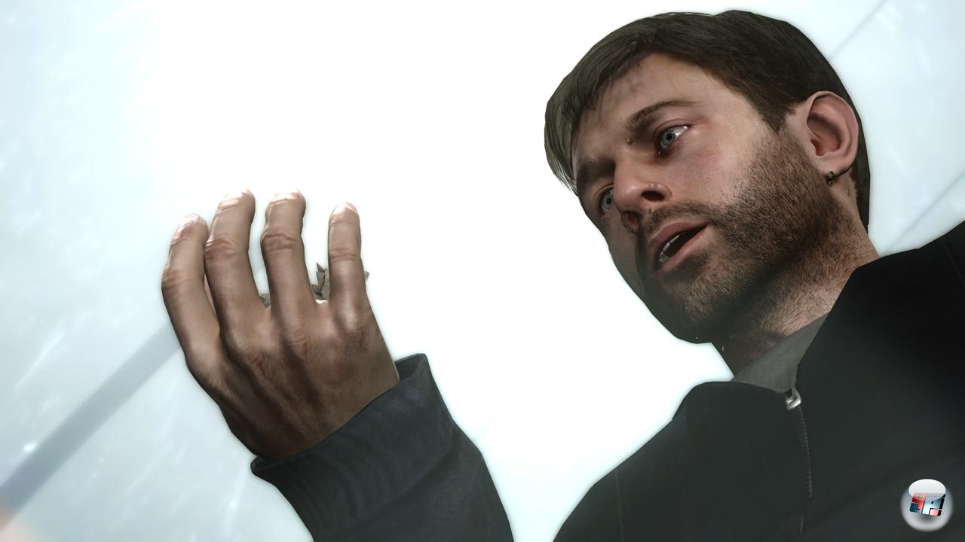
Game Summary
Installation
Put the disc in a PS3.
May need to download updates.
Scoring
No scoring system.

Slide 13
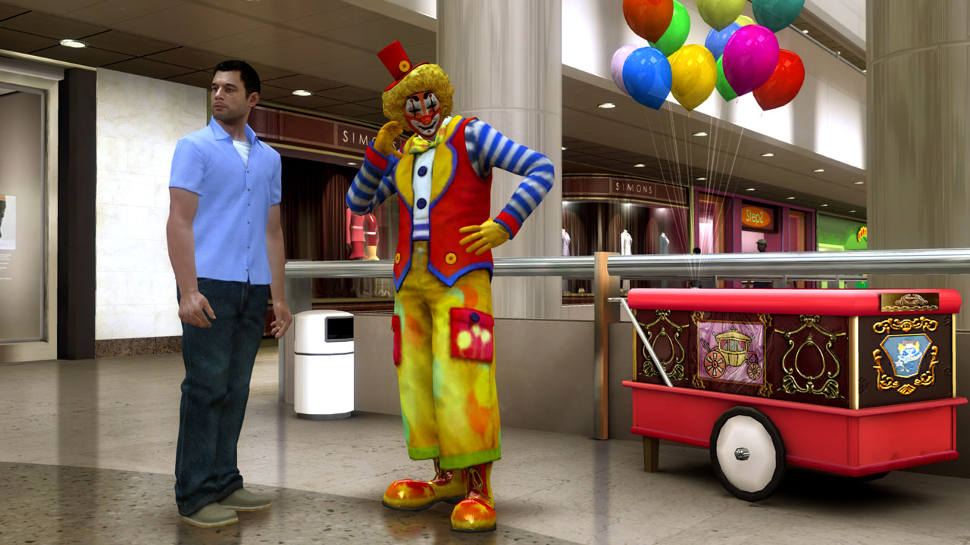
Game Summary
Manual
Basic instruction
manual. You can
learn everything
in game.
Bugs
Freezes.
Fails to load new scenes.
I’ve never experienced these, just heard about them online.

Slide 14
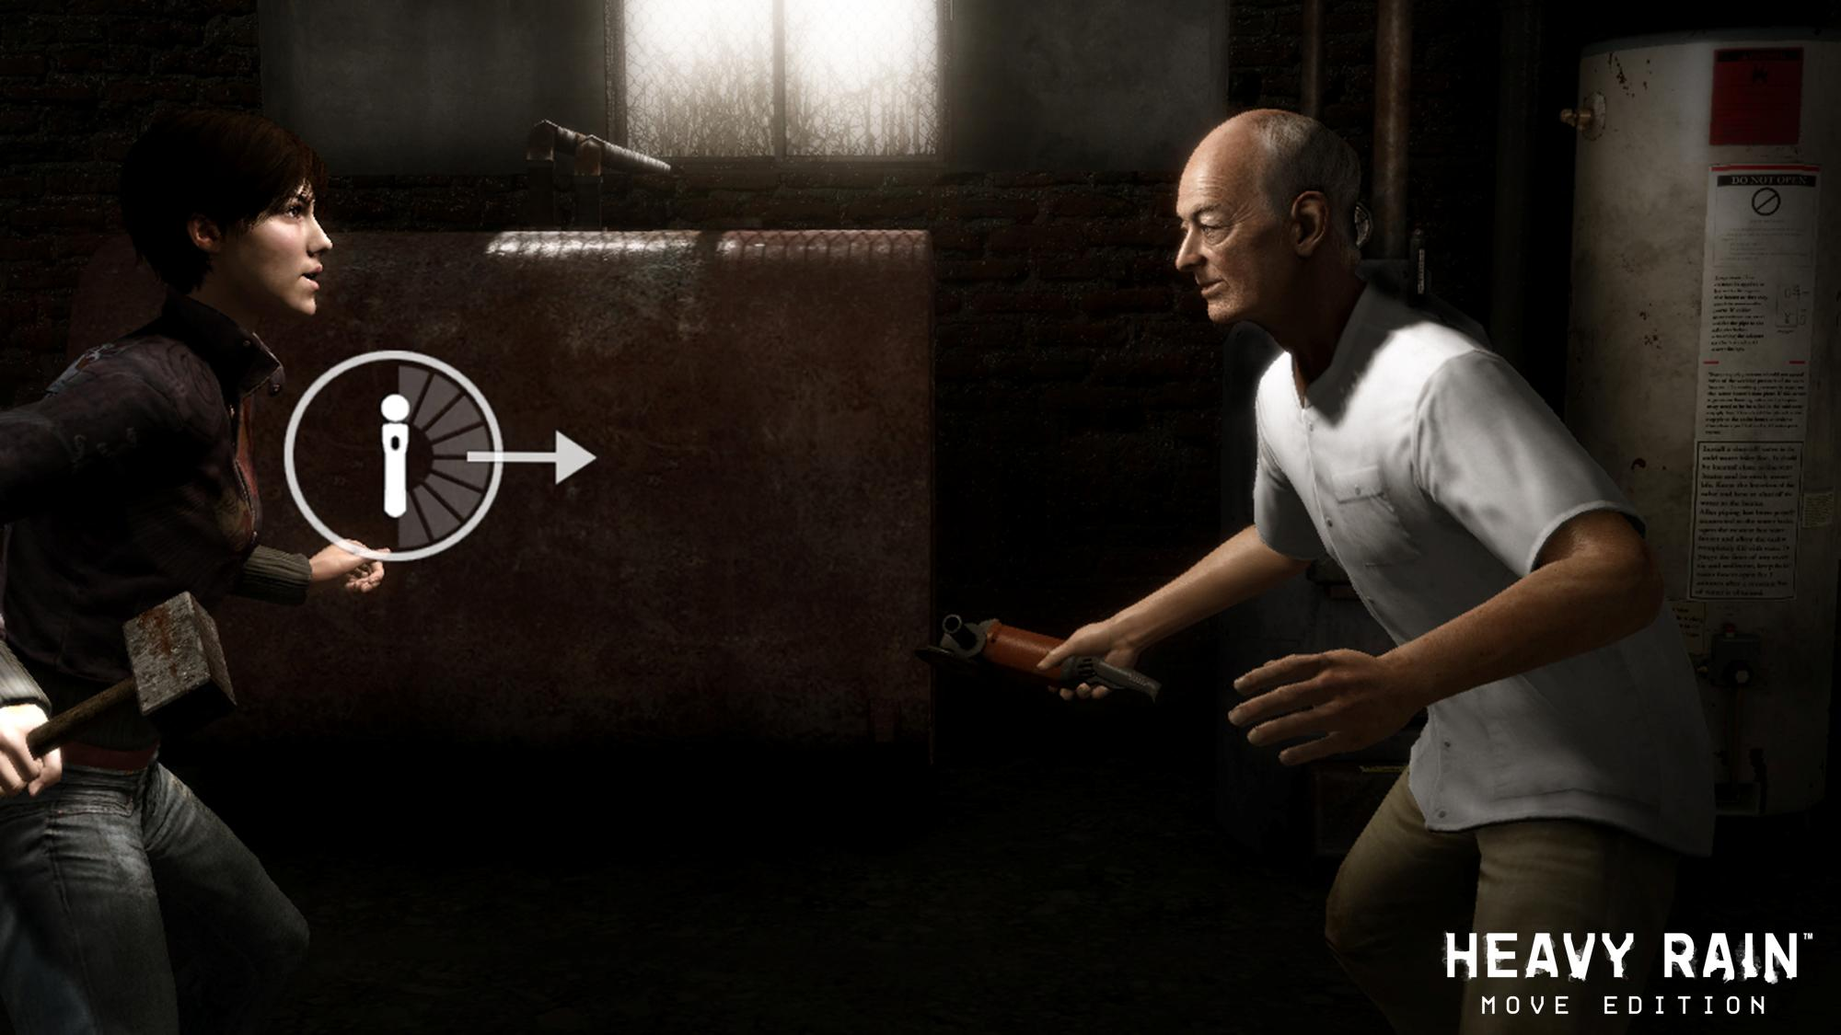
Game Review
The good
Great story.
Beautiful art
and music.
Great
dialogue.
Clean UI that
emphasizes the cinematic aspect of the game.
Multiple endings. What you do actually matters.

Slide 15
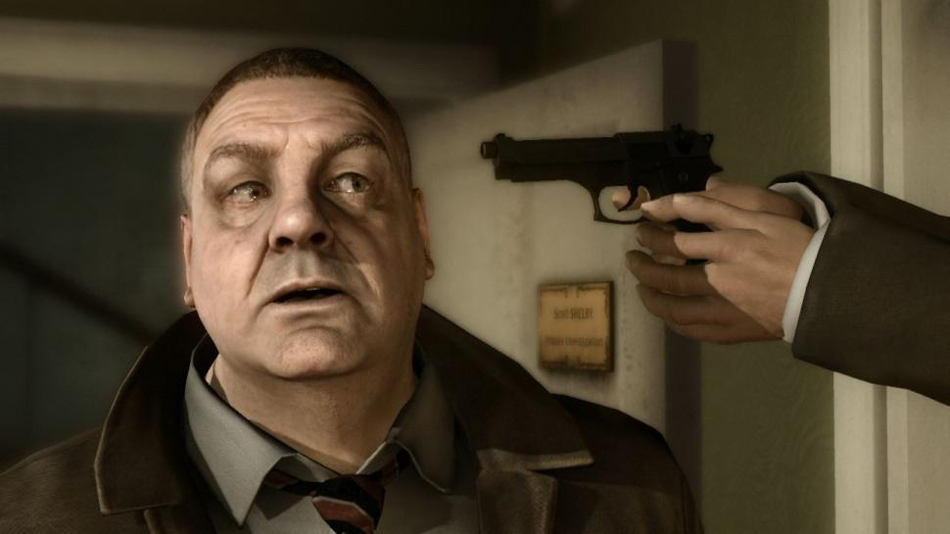
Game Review
The Bad
Walking takes left stick and R2.
Europeans are voicing Americans, so some of the voice acting is spotty.
Story is a bit slow in the beginning.
Occasional over realism.
Hit or miss animation.
Short. One play through should only take about 8 hours.

Slide 16
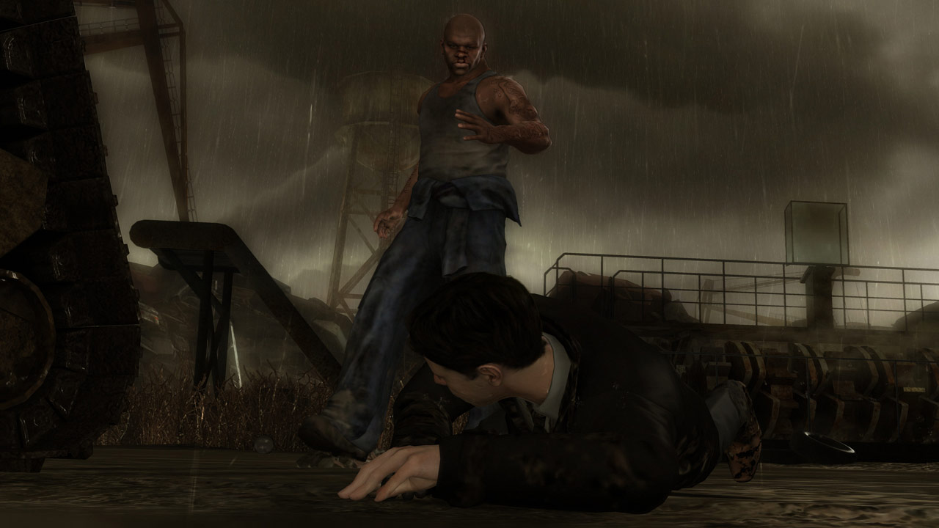
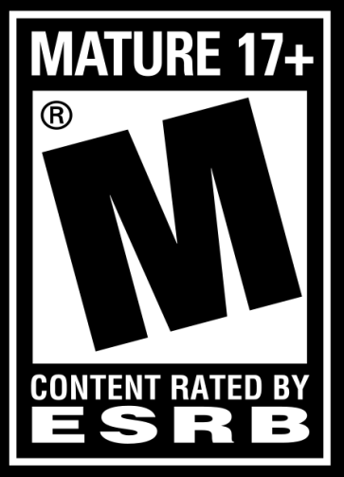
Game Review
Audience
Rated M for Blood, Intense Violence, Nudity, Sexual Content, Strong Language, Use of Drugs.
Meant for adults who want to watch and help make a good story unfold.

Slide 17
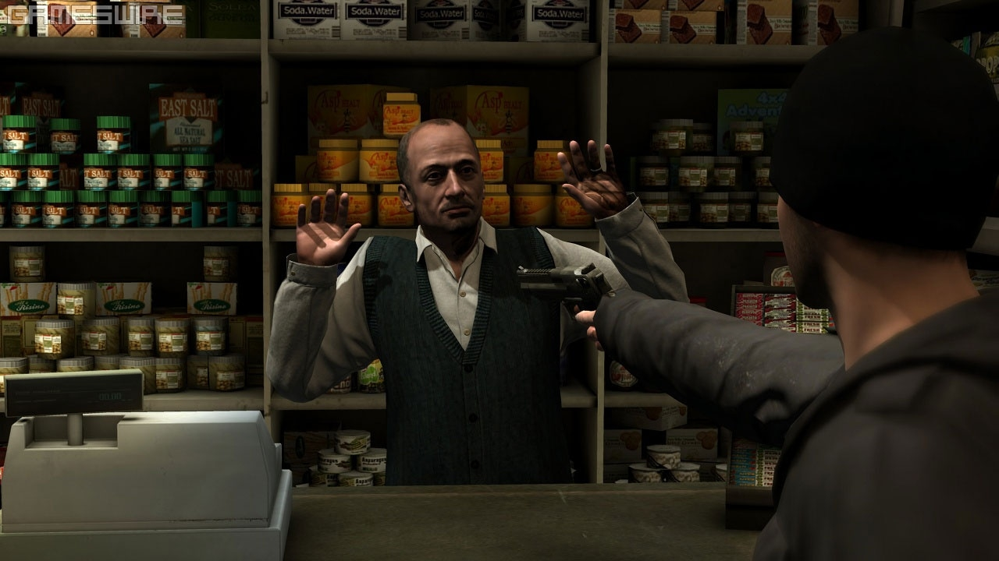
Game Review
Comparison
Very few games in the same genre.
Indigo Prophecy
Made by same developers.
HR is more of an interactive movie, while IP has more classical game elements.
They had similar controls, which worked better with HR than IP.
HR had a better story.
HR was overall the better game.

Slide 18
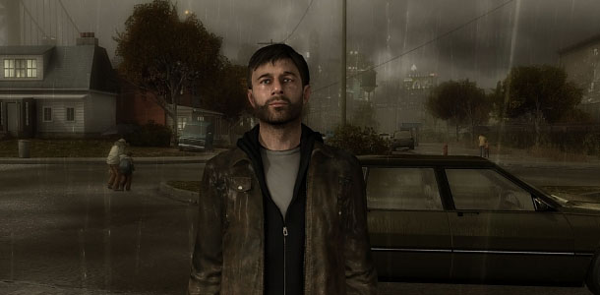
Summary
Strengths
Story.
Art and music.
Weaknesses
Voice acting.
Animation.
Possible Improvements
Walk with only the left stick.
Improve the weaknesses.
Get rid of some parts in the beginning where you have to wait.

Slide 19
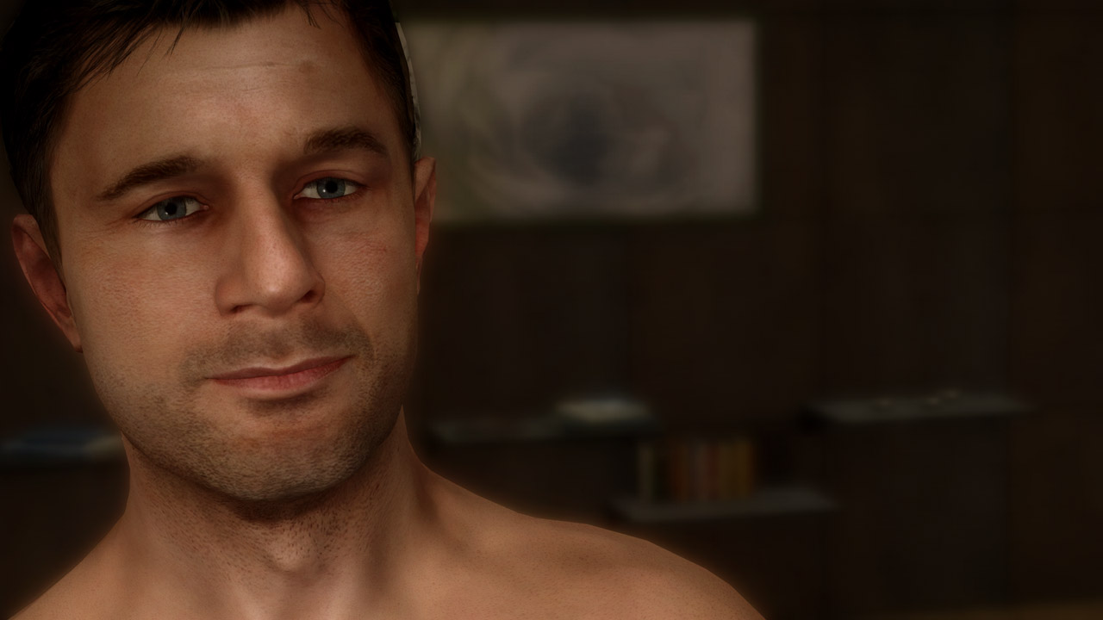
Game Summary
Is it worth purchasing?
Yes!

Slide 20
